Slide 1
Lecture № 2
Plant tissue
al-Farabi Kazakh National University
Faculty of Biology and biotechnology
Department of Biodiversity and Bioresources

Slide 2
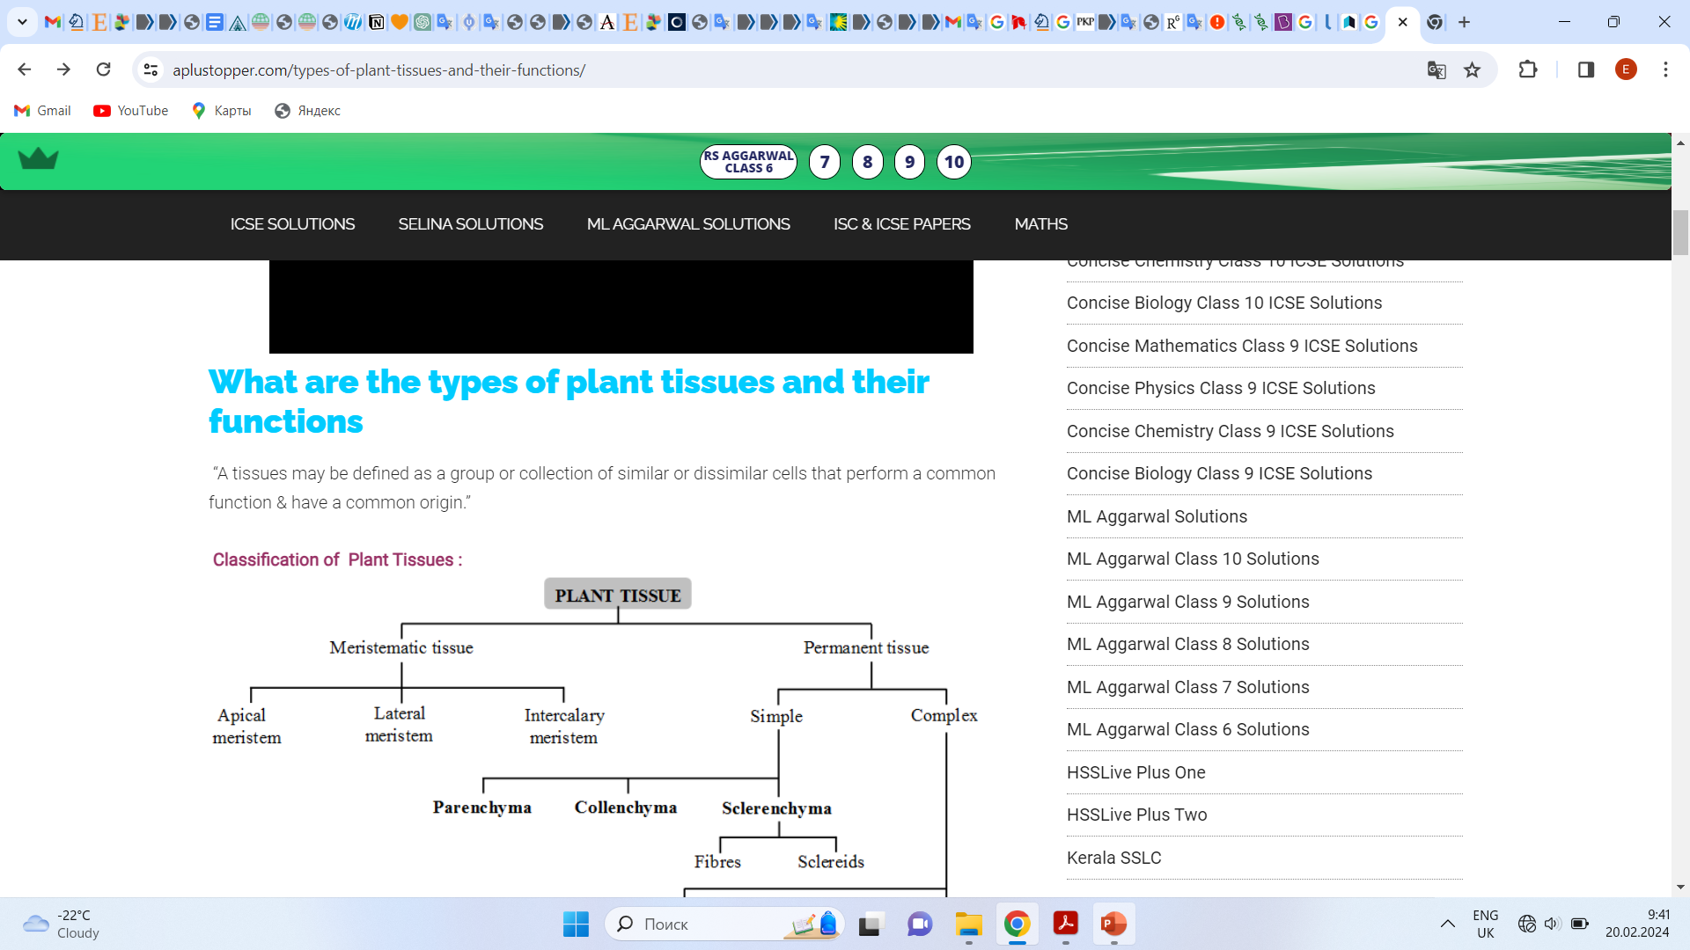
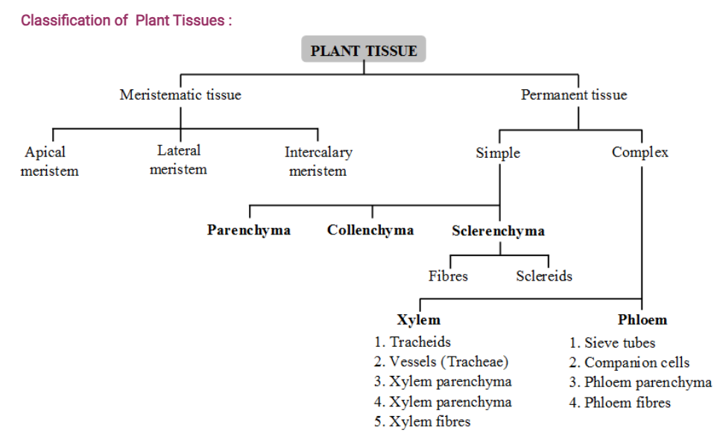

Slide 4
Meristematic tissue :
Meristematic tissues may be defined as a group or collection of living cells which are located specific locations and divide continuously to add new cells to the plant body.
Characteristics of meristematic tissues :
The cells of meristematic tissues are similar in structure and have thin and elastic primary cell walls made up of cellulose.
These meristematic cells may be rounded, oval, polygonal or rectangular in shape.
They are compactly arranged without intercellular spaces between them.
Each cell contains dense or abundant cytoplasm and a large prominent nucleus.
The dense protoplasm of meristematic cell contains few small vacuoles or no vacuoles at all.

Slide 5
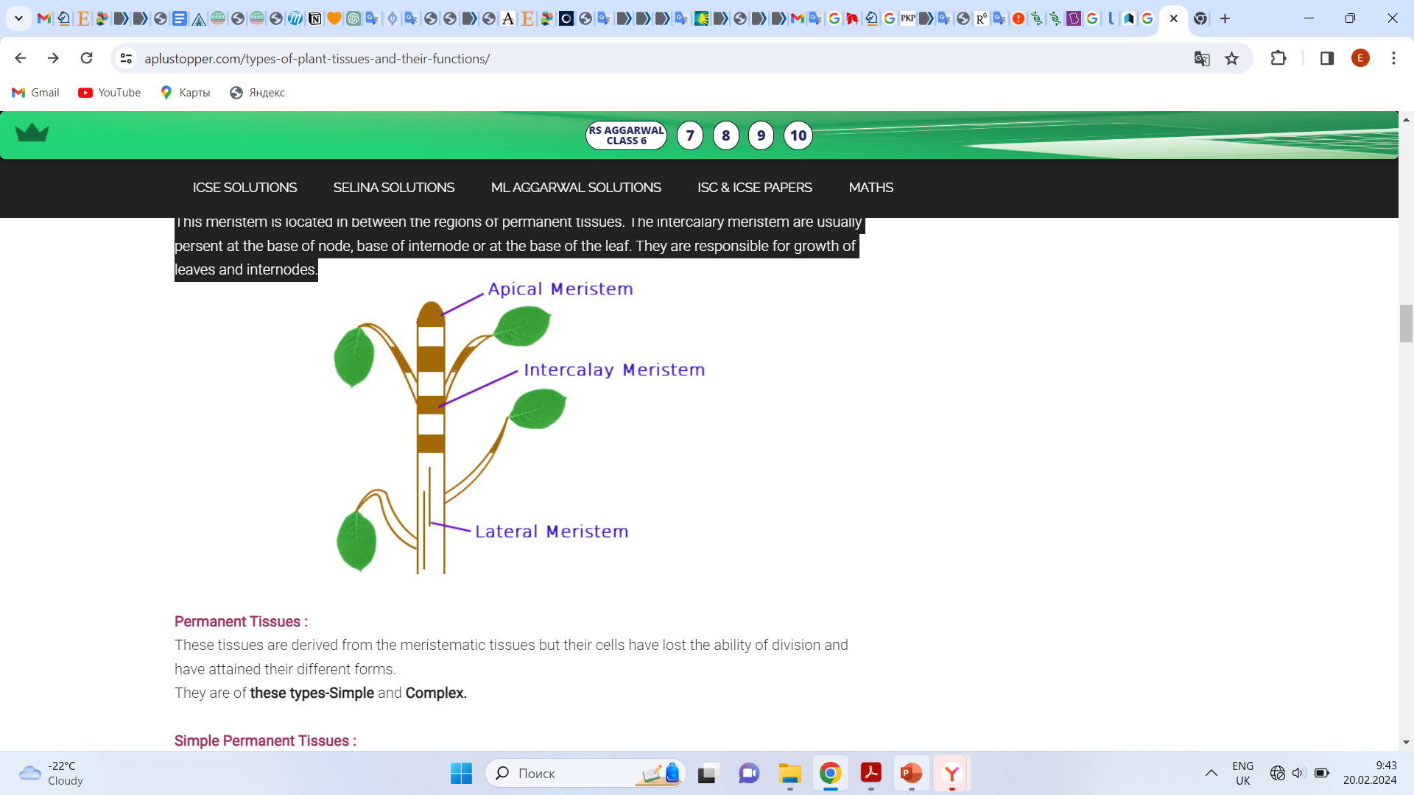
1. Apical meristem :
This meristem is located at the growing apices of main and lateral shoots and roots. These cells are responsible for linear growth of an organ. Example root apical meristem and shoot apical meristem.
2. Lateral meristem :
This meristem consists of initials which divide mainly in one plane and cause the organ to increase in diameter and girth. The lateral meristem usually occurs on the sides both in stem and root. Lateral meristem is of two types, i.e., in the form of cork cambium and in vascular bundles of dicots in the form of vascular cambium. The activity of this cambium results in the formation of secondary growth.
3. Intercalary meristem :
This meristem is located in between the regions of permanent tissues. The intercalary meristem are usually present at the base of node, base of internode or at the base of the leaf. They are responsible for growth of leaves and internodes.

Slide 6
Permanent Tissues :
These tissues are derived from the meristematic tissues but their cells have lost the ability of division and have attained their different forms.
They are of these types-Simple and Complex.
*Simple Permanent Tissues :
These tissues are made up of cells which are structurally and functionally similar. These are of three types –
Parenchyma
Collenchyma
Sclerenchyma
* Complex Permanent Tissues :
Complex tissues are of following two types. They are Xylem and Phloem

Slide 7
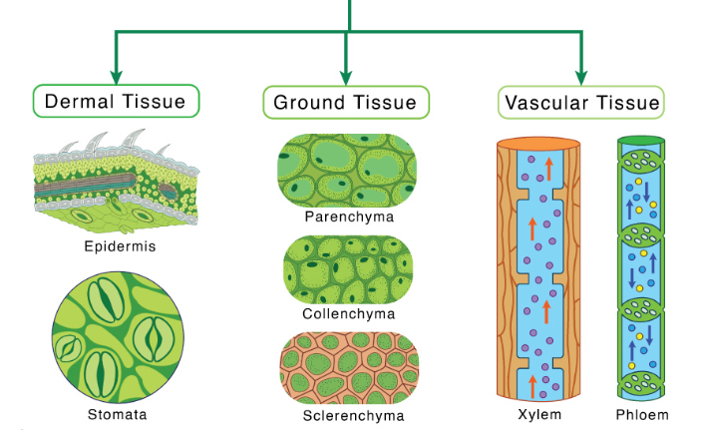
PERMANENT TISSUE

Slide 8
1. Dermal Tissue
Dermal tissue forms the outermost covering of the plant, called the epidermis. In stems and leaves, the dermal tissue is covered by a waxy cuticle that prevents water loss due to transpiration. In the leaf, some minute openings called stomata (singular: stoma) in the cuticle layer allow gas exchange. Each stoma is covered by a pair of bean-shaped guard cells that regulates its opening and closing.
Unlike stems and leaves, the dermal layer of root gives rise to some lateral outgrowths called root hairs. Trichomes, or small hairlike or spikey outgrowths of epidermal tissue, sometimes found on the stem and leaves, aid in defense against herbivores.
In woody plants, the epidermis breaks into a multi-layered periderm (or bark) as secondary growth allows plants to grow in girth. The periderm functions as the plant’s first line of defense, protecting it from injury, dehydration, fire, and pathogens.

Slide 9
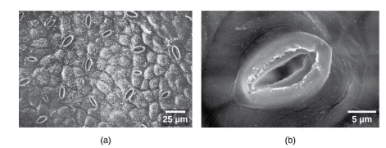
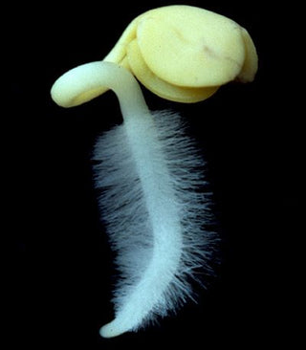
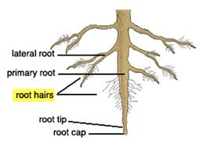
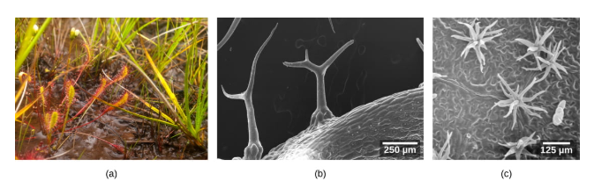
Guard cells: To permit gas exchange for photosynthesis and respiration, the epidermis of the leaf and stem also contains openings known as stomata (singular: stoma). Two cells, known as guard cells, surround each leaf stoma, controlling its opening and closing and thus regulating the uptake of carbon dioxide and the release of oxygen and water vapor.
Root hairs: Root hairs are microscopy extensions of root epidermal cells which increase the surface area of the root, greatly contributing to the absorption of water and minerals.
Trichomes: Stems and leaves of some plants also have trichomes, spiky or hair-like structures on the epidermal surface that help to reduce transpiration (the loss of water by aboveground plant parts), increase solar reflectance, and store compounds that defend the leaves against predation by herbivores.
Trichomes

Slide 10
2. Ground Tissue
Ground tissue comprises much of the interior of a plant and helps in metabolism, storage, and support. Depending on location and function, ground tissues are made of three cell types:
a. Parenchyma
They are spherical, elongated cells with a thin and flexible primary cell wall but lack a secondary cell wall. Parenchyma cells are totipotent and thus have the ability to divide and differentiate into any cell. They are the main component of young plant organs. They are found in almost all cell types, such as in mesophyll cells, stem cortex, and pith, and as a component of vascular tissues
b. Collenchyma
Like parenchyma cells, collenchyma also lacks secondary cell walls but is thicker than primary cell walls. As their cells are long and thin, they can stretch and elongate, which helps them provide structural support in growing regions of the stem and leaves.
c. Sclerenchyma
Unlike other ground tissues, sclerenchyma has secondary cell walls composed of lignin. This tough substance is the primary component of wood. So, these cells cannot stretch and are dead. They provide structural support to the plant.

Slide 11
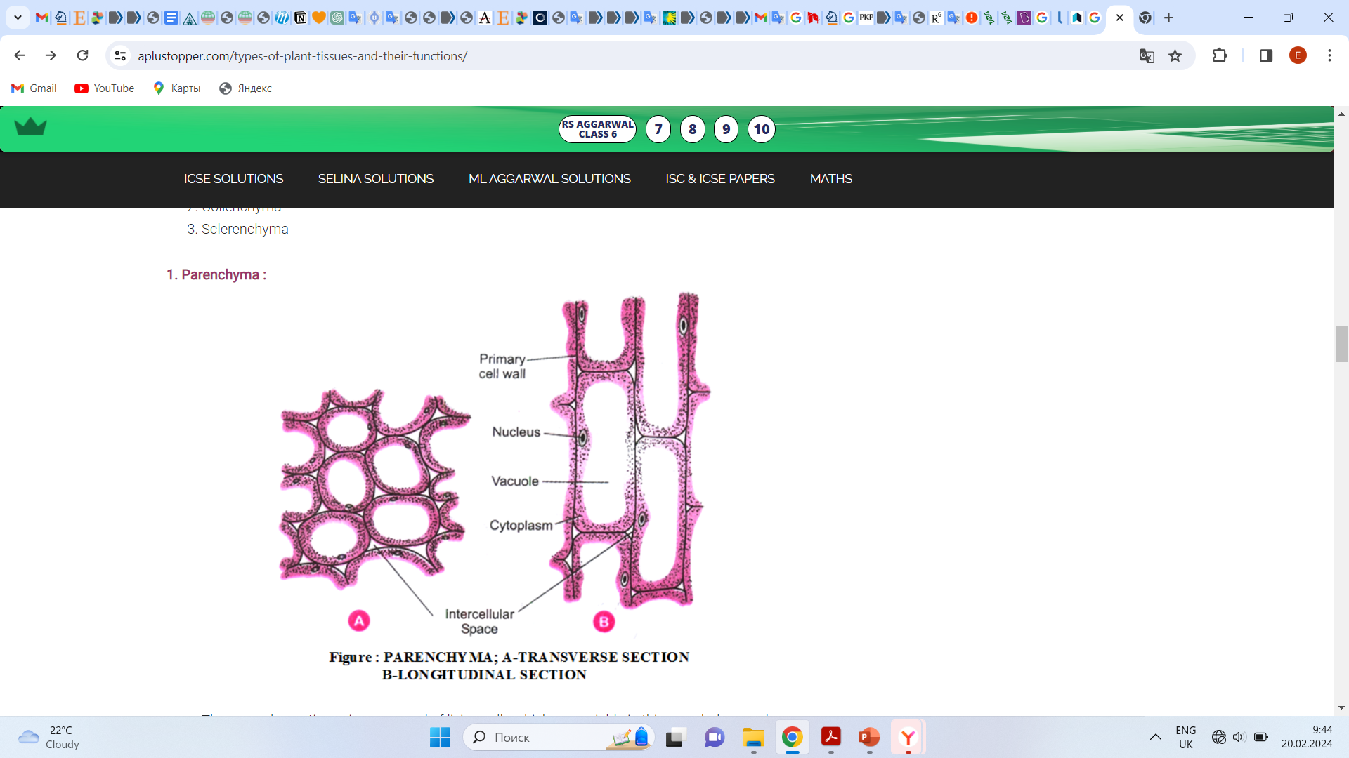
1. Parenchyma :
The parenchyma tissue is composed of living cells which are variable in thin morphology and physiology but generally having thin wall and a polyhedral shape and concern with vegetative activities of the plant.
They have inter cellular spaces between them.
They act as storage for food and water

Slide 12
Types of Parenchyma :
Aerenchyma :
  In hydrophytes, the intercellular space between cells become wide & filled with air.
  Such a parenchymatous tissue having large air spaces is called Aerenchyma.
  These help in gaseous exchange and provide buoyancy to plant.
Chlorenchyma :
  When parenchyma is richly supplied with chloroplasts, it is called chlorenchyma.
  They are found in leaf mesophyll, sepals, phylloclades, phyllodes, cladodes etc. It is photosynthetic in function and posses chlorophyll.

Slide 13
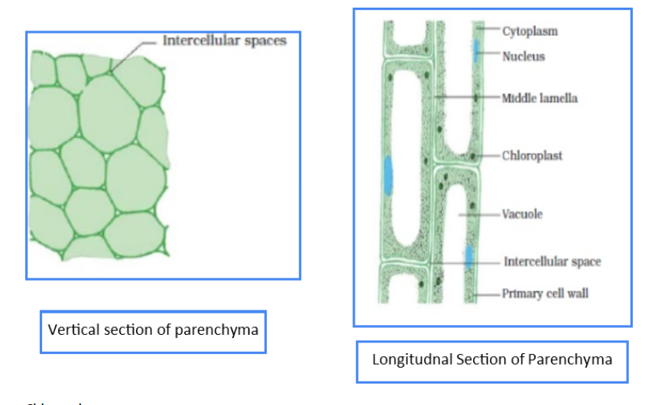

Slide 14
2. Collenchyma :
It was discovered and coined by Schleiden (1839).
The cells are living with intercellular space in between the cells or junctional places filled with cellulose and pectin.
Generally they are longer than parenchyma
Usually they are known as living mechanical tissue owing to their supportive functions.
It provides flexibility and strength to young plant organ.

Slide 15
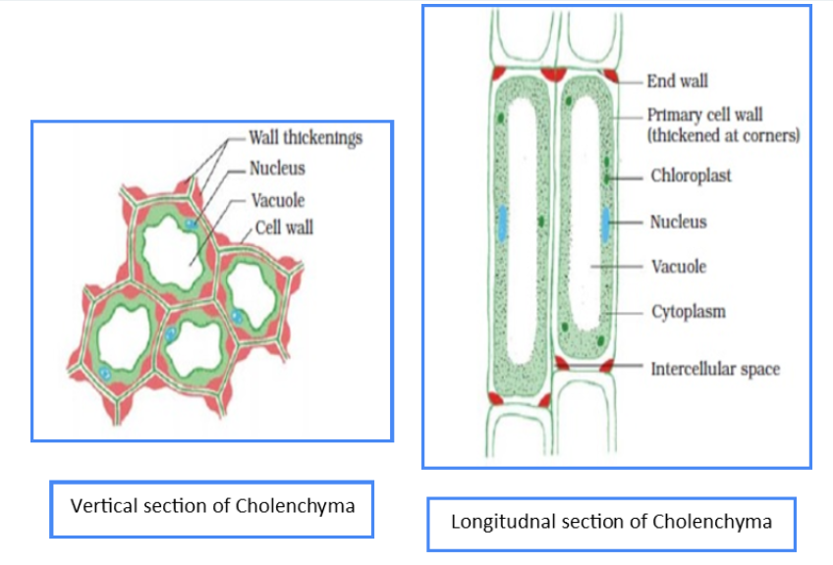

Slide 16
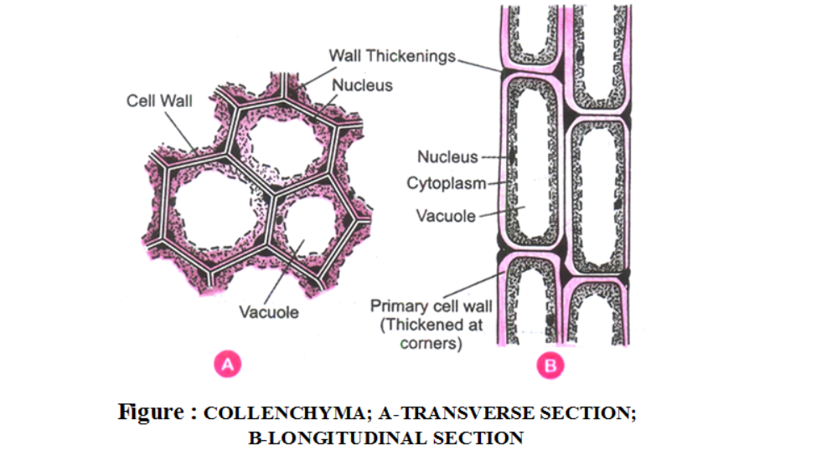
3. Sclerenchyma :
They were discovered and coined by Mettenius (1805).
The cells are long, narrow, pointed at ends, thick walled and lignified. They are the dead cells.
It impart hardness to plant parts and give mechanical strength.

Slide 17
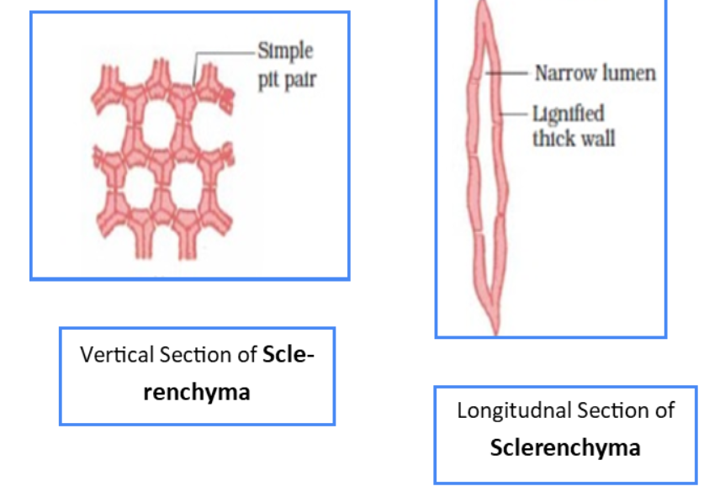

Slide 18
Complex permanent tissues :
Complex tissues are of following two types. They are Xylem and Phloem

Slide 19
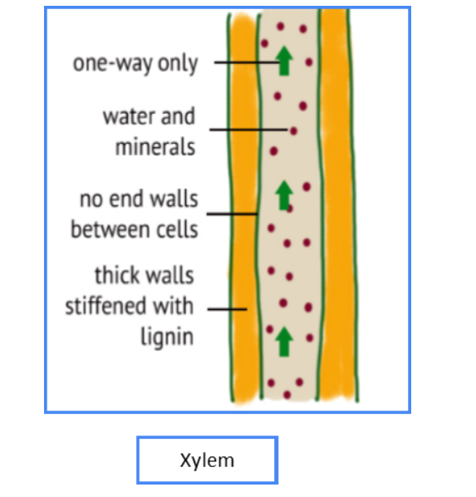
Xylem :
Its main function is conduction of water and mineral salts from root to the top of plant.
Primary xylem elements originate from procambuim of apical meristem.
Secondary xylem elements originate from the vascular cambium of lateral meristem.
The xylem elements are of 4 types : xylem tracheids, vessels, fibers and parenchyma.

Slide 20
Xylem Tracheids :
  These are lignified and dead cells with bordered pits.
  They help in conduction of water in pteridophytes and gymnosperms and provide mechanical support plants.
Xylem Vessels :
  The cells are long and tubular with lignified cell wall.
  The cross wall (end wall) at both the ends dissolves and form a pipe like channel.
  They help in ascent of sap in angiosperms.
Xylem Fibers :
  Long and narrow sclerenchymatous fibers with tapering end. The wall is heavily lignified leaving a very narrow Lumen.
  It provides tensile strength and mechanical strength.
Xylem Parenchyma :
  They are thin walled living cells present in both primary and secondary xylem.
  They store food materials.

Slide 21
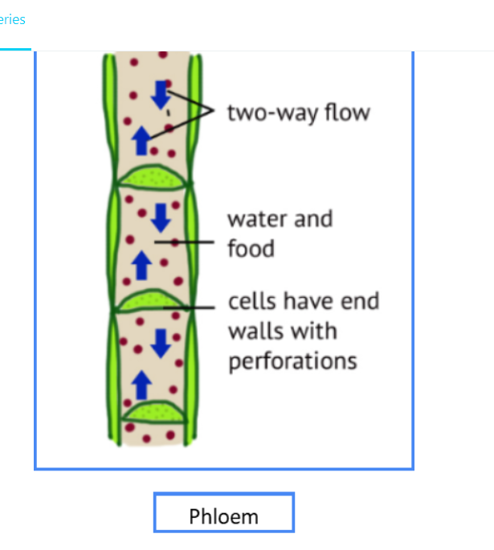
Phloem :
The dead matter in them is known as bast. Its main function is conduction of food material from leaves to other plant parts.
The phloem elements are of four type : Sieve tubes, Companion cells, Fibres and paranchyma.

Slide 22
Sieve Tubes :
  These are living but lack nucleus at maturity.
  Cell wall is thin and made up of cellulose.
  The transverse walls of sieve tube form sieve plate.
  They help in conduction of food material.
Companion Cells :
  The cells are living, thin walled, narrow and found attached to the lateral side of sieve element.
  They are absent in pteridophytes and gymnosperms.
  They support the sieve tube in transport of food.
  These are living and thin walled cells.
  They are absent all monocots and some dicots.
Phloem Fibers (bast fibers) :
  These are sclerenchymatous fibers having thick wall and narrow Luman.
  They provide mechanical support to the plant.
Phloem Parenchyma
  The chief function of parenchyma is to store food material and other substances like mucilage, tanins and resins.

Slide 23
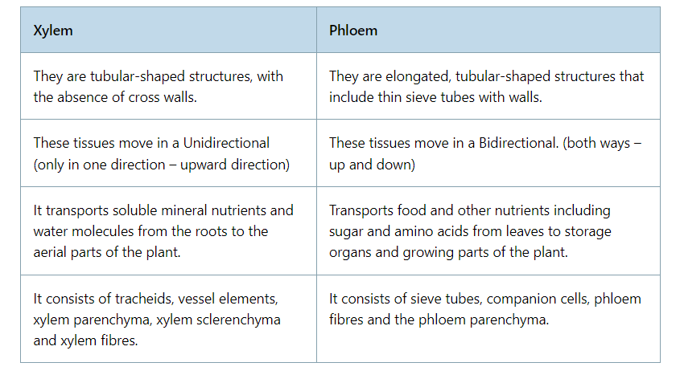

Slide 24
Protective Tissue :
It includes epidermis, cork, trichomes, guard cells

Slide 25
1. Epidermis :
  It is usually present in the outermost layer of the plant body such as leaves, flowers, stem and roots.
  Epidermis is one cell thick and is covered with cuticle.
  Cuticle is a water proof layer of a waxy substance called cutin which is secreted by epidermal cells.
  The main function of epidermis is to protect the plant from desication and infection.

Slide 26
2. Cork :
  As roots and stem grow older with time (increase in girth), tissues at the periphery become cork cell.
  Cork cells are dead cells and they do not have any intercellular spaces.
  The walls of cork cells are heavily thickened by the deposition of an organic substance
  (a fatty substance), called suberin.
  Cork is protective in function. cork cells prevent desiccation (loss of water from plant body), infection and mechanical injury.
  Cork is produced by cork cambium commereially it is obtained from oak (quercus suber).
  Cork is used for making insulation boards, sports goods, bottle corks etc.

Slide 27
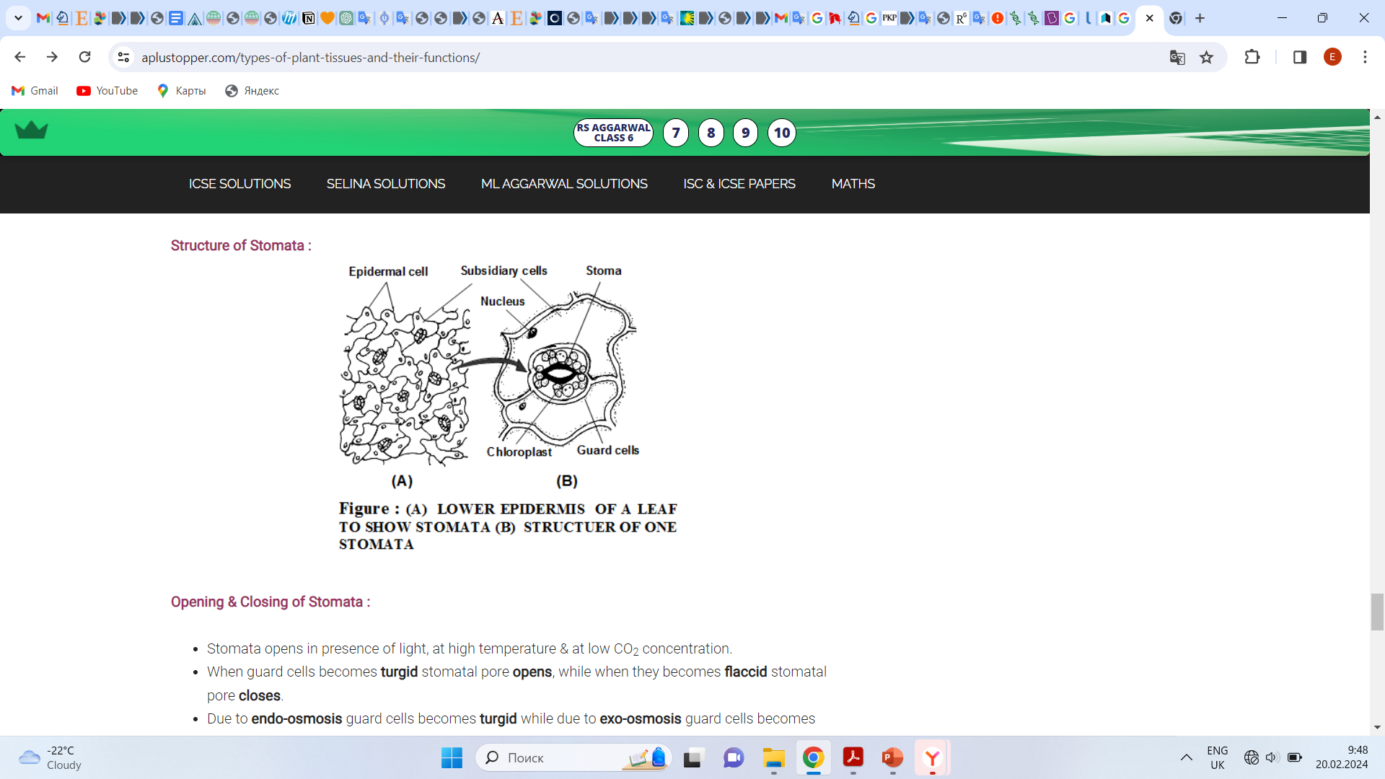
Stomata :
Epidermis of a leaf is not continuous at some places due to the presence of small pores, called stomata.
Each stomata is bounded by a pair of specialized epidermal cells called guard cells. The stomata allows gaseous exchange to occur during photosynthesis and respiration.

Slide 28
Opening & Closing of Stomata :
Stomata opens in presence of light, at high temperature & at low CO₂ concentration.
When guard cells becomes turgid stomatal pore opens, while when they becomes flaccid stomatal pore closes.
Due to endo-osmosis guard cells becomes turgid while due to exo-osmosis guard cells becomes flaccid.
Due to increase in the amount of osmotically active sugars in guard cells, their osmotic pressure increases and water enters inside the cells increasing the turgidity of cells and hence stomata opens.
When amount of sugar decreases, stomata closes. Several theories have been proposed by the scientist to explain the opening and closing of stomata.

Slide 29
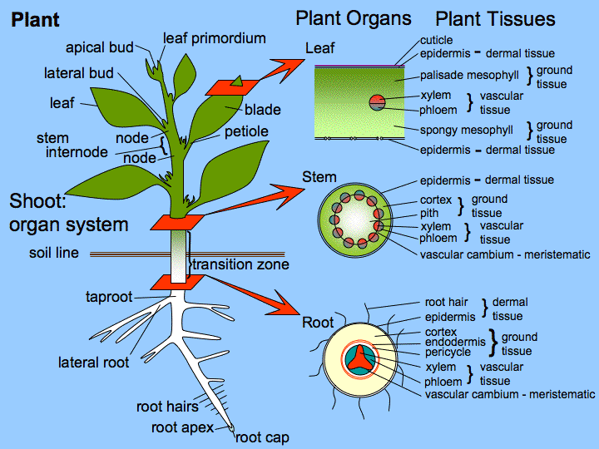

Slide 30
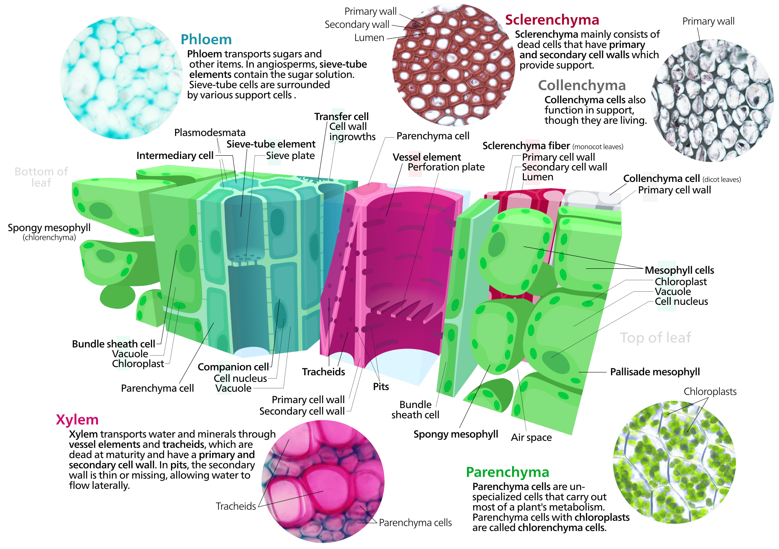

Slide 31
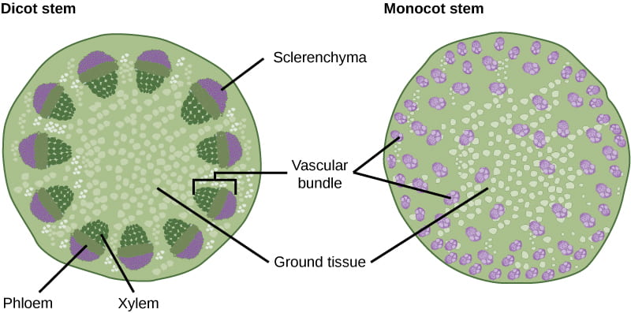
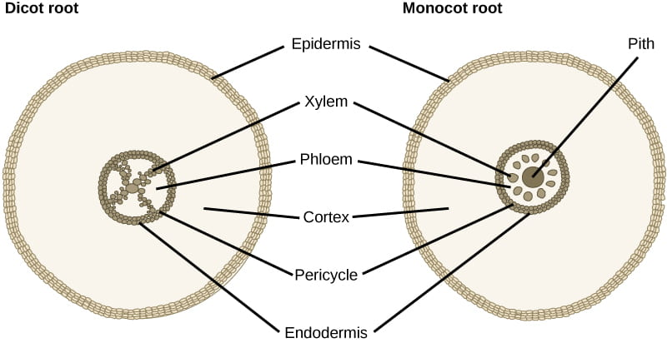
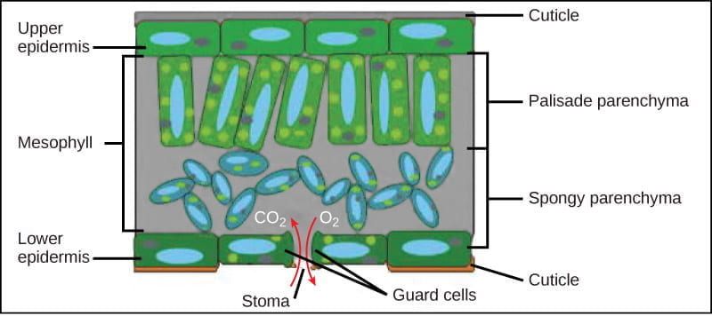
Tissue Arrangements in Dicots vs Monocots

Slide 32
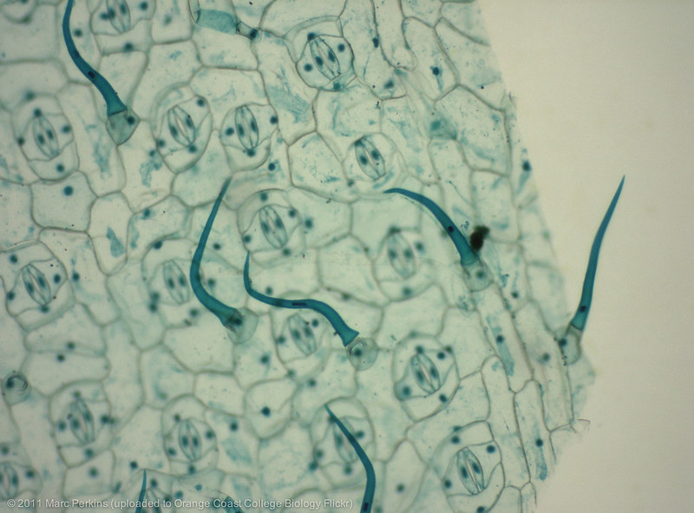
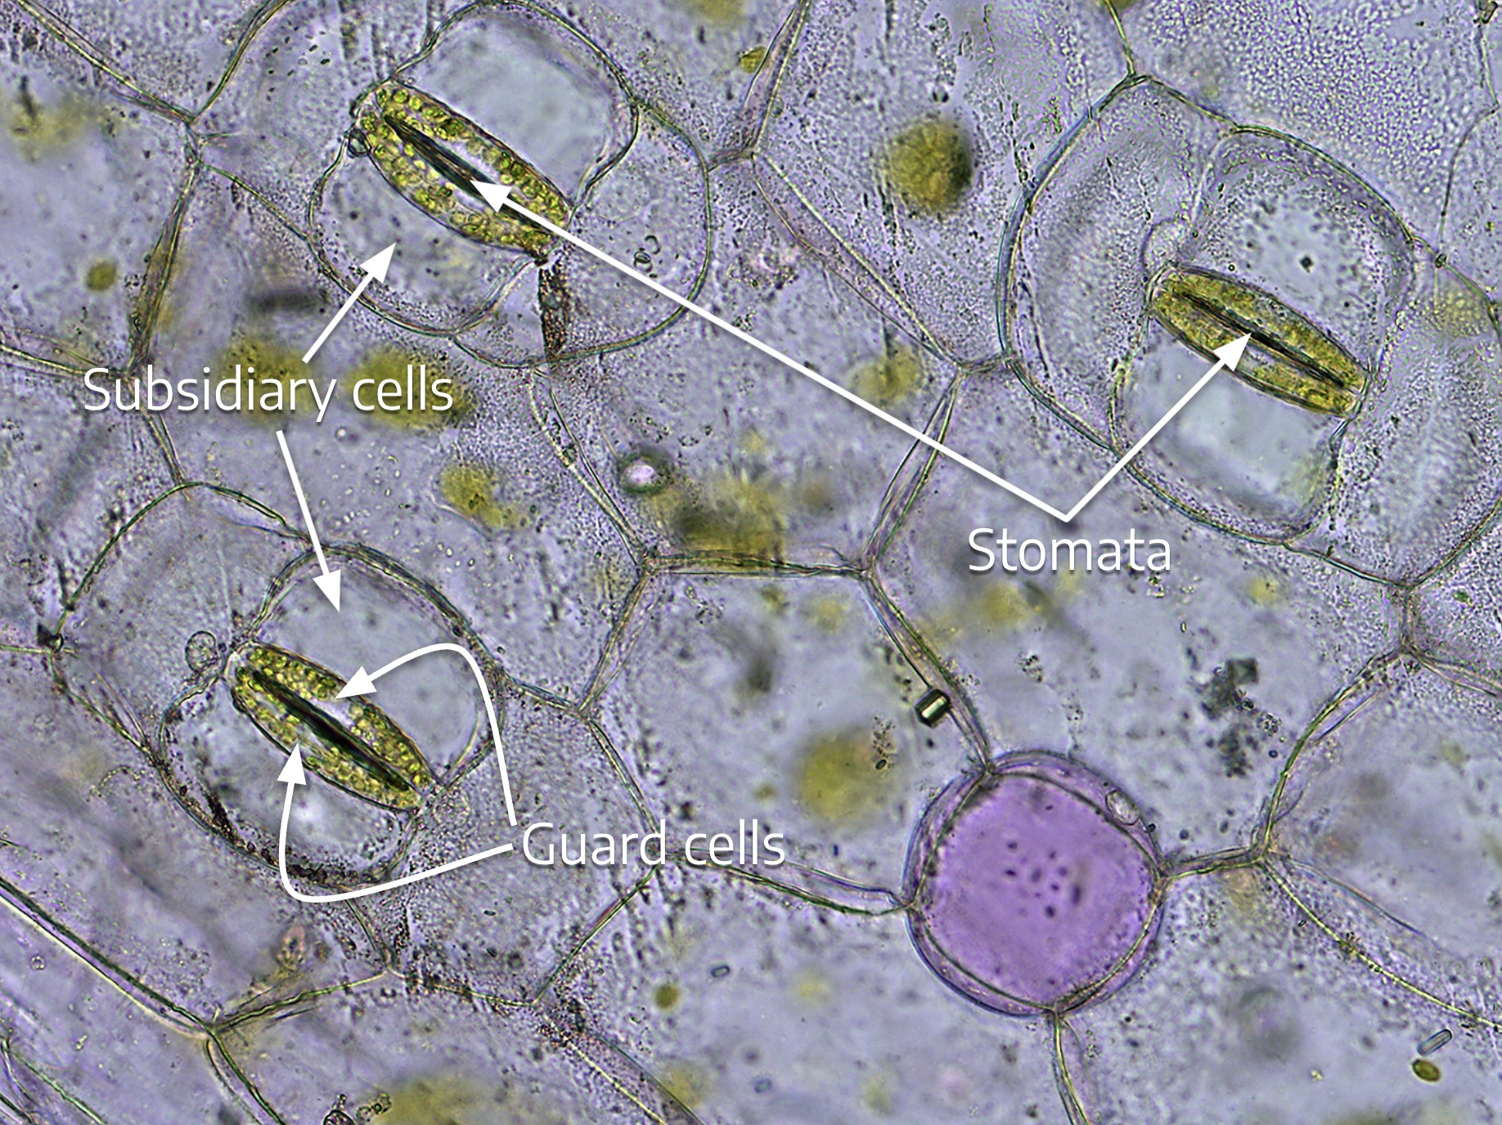

Slide 33
